Slide 1
Module 6 Software Evolution

Slide 2
Topics
Software Maintenance
Types of Maintenance,
Software Configuration Management
Overview – SCM Tools.
Re-Engineering
Reverse Engineering
Software Reuse

Slide 3
Software Maintenance
The goal of software maintenance is to keep the software system working correctly, efficiently, and securely, and to ensure that it continues to meet the needs of the users.
This can include fixing bugs, adding new features, improving performance, or updating the software to work with new hardware or software systems.
It is also important to consider the cost and effort required for software maintenance when planning and developing a software system.
It is important to have a well-defined maintenance process in place, which includes testing and validation, version control, and communication with stakeholders.
It’s important to note that software maintenance can be costly and complex, especially for large and complex systems. Therefore, the cost and effort of maintenance should be taken into account during the planning and development phases of a software project.
It’s also important to have a clear and well-defined maintenance plan that includes regular maintenance activities, such as testing, backup, and bug fixing.

Slide 4
Need for Software Maintenance
Software Maintenance must be performed in order to:
Correct faults
Improve the design
Implement enhancements
Interface with other systems
Accommodate programs so that different hardware, software, system features, and telecommunications facilities can be used.
Migrate legacy software.

Slide 5
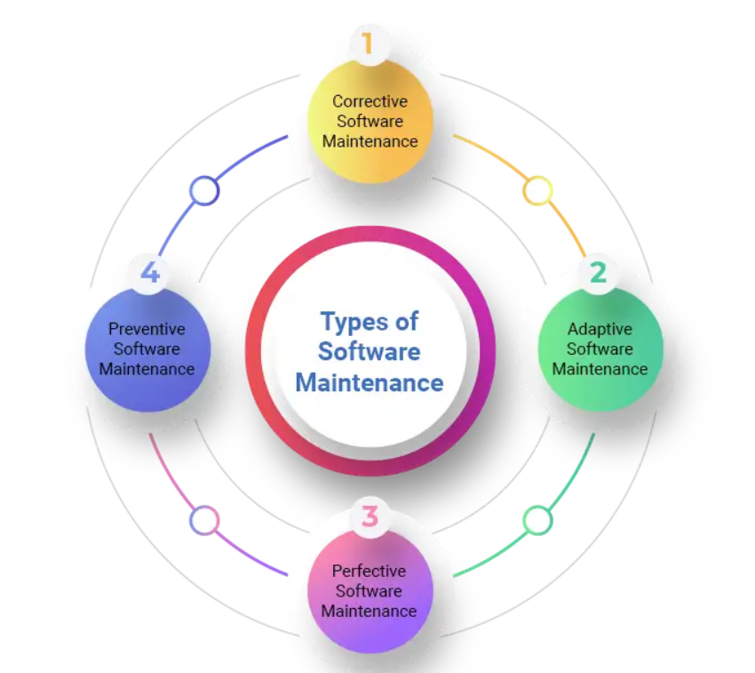
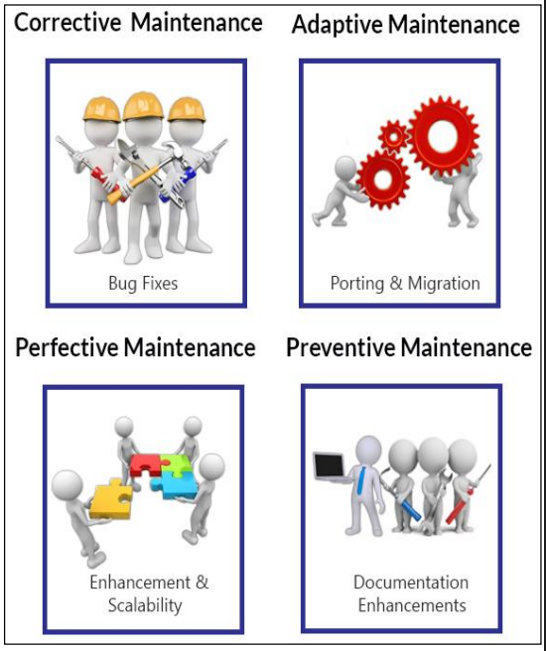

Slide 6
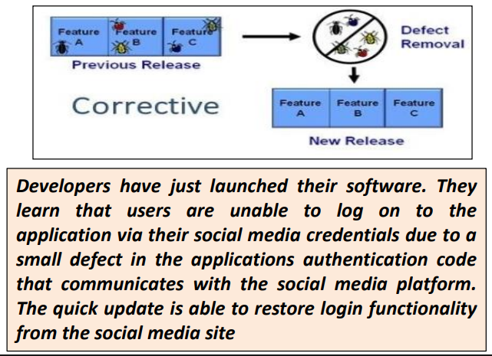
Corrective Software Maintenance
This process of identifying and resolving flaws, errors, or problems that are found in software that is regularly used.
This kind of maintenance fixes issues that users have reported or that testing and monitoring have found, to get the product back to working as intended.
Reliability of software operation is ensured, and downtime is minimized with corrective maintenance.
Key Activities:
Recognizing and fixing errors or inaccuracies that have been reported.
Analyzing the root cause of errors.
Creating and putting into use patches or fixes.
Testing to confirm whether corrective measures are working.
Deploying updates into operational settings.

Slide 7
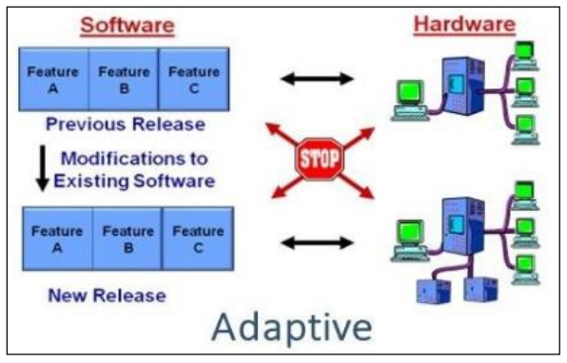
Adaptive Maintenance
It refers to the process of evolving software to take advantage of environmental changes, such as operating system updates, hardware improvements, or new legal requirements.
This kind of upkeep guarantees that the program will continue to work and be compatible with changing commercial and technical contexts.
Adaptive maintenance is necessary to increase the software's longevity and usability.
Key Activities:
Evaluating how the software is affected by changes in the environment.
Adjusting code or configurations to meet new specifications.
Validating compatibility and performance through testing.
Documentation is being updated to reflect changes.
Implementing modifications in operational settings.

Slide 8
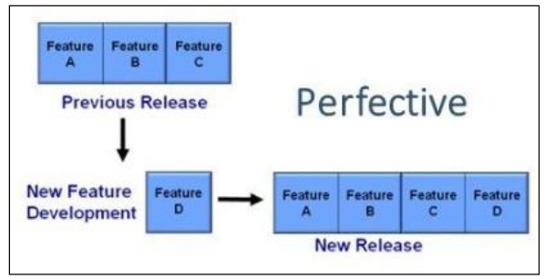
Perfective Maintenance
Perfective Software Maintenance
The goal of perfective maintenance is to improve the software's usability, effectiveness, or performance without affecting its essential features.
The goal of this kind of maintenance is to improve software features in response to user input, new developments in technology, or changing business requirements.
Enhancing user pleasure and program quality are two benefits of perfective maintenance.
Key Activities:
Examining requests for enhancements and feedback from customers.
Identifying where features or performance might be improved.
Rewriting code to make it more scalable and maintainable.
Implementing new features or upgrades into practice.
Testing modifications to make sure they adhere to quality requirements.

Slide 9
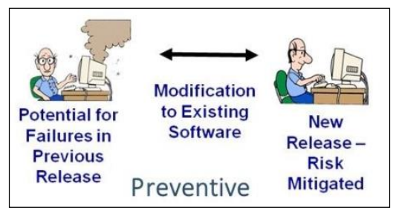
Preventive Maintenance
Identifying and resolving problems before they become faults or problems is the goal of preventive maintenance.
By putting policies in place to improve software stability and resilience, this kind of maintenance aims to lower the probability of malfunctions or performance degradation in the future.
By reducing risks and enhancing overall program reliability, preventive maintenance helps.
Key Activities:
To find possible vulnerabilities, do code reviews and analysis.
Applying updates and security patches.
Maximizing the use of available resources to avoid performance complexities.
Performing recurring health checks and system audits.
Putting backup and disaster recovery plans into action.

Slide 10
Software Configuration Management

Slide 11
Software Configuration Management
Configuration management (CM) is concerned with the policies, processes, and tools
for managing changing software systems.
Configuration management is useful for individual projects as it is easy for one person to forget what changes have been made.
It is essential for team projects where several developers are working at the same
time on a software system.
Configuration management tools are used to
Store versions of system components
Build systems from these components
Track the releases of system versions to customers
Keep track of change proposals
CM tools range from simple tools that support a single configuration management task, such as bug tracking, to integrated environments that support all configuration management activities.

Slide 12
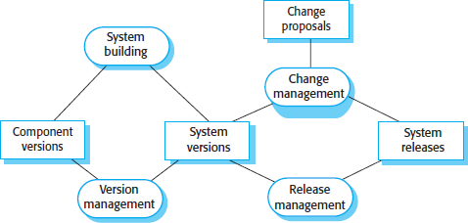
The configuration management of a software system product involves four closely
related activities
1. Version control
This involves keeping track of the multiple versions of system components and ensuring that changes made to components by different developers do not interfere with each other.
System building
This is the process of assembling program components, data, and libraries, then
compiling and linking these to create an executable system.
Change management
This involves keeping track of requests for changes to delivered software from customers and developers, working out the costs and impact of making these changes, and deciding if and when the changes should be implemented.
Release management
This involves preparing software for external release and keeping track of the system versions that have been released for customer use.

Slide 13
The development of a software product or custom software system takes place in
three distinct phases:
1. A Development Phase
The development team is responsible for managing the software configuration and
new functionality is being added to the software.
The development team decides on the changes to be made to the system.
2. A System Testing Phase
A version of the system is released internally for testing.
This may be the responsibility of a quality management team or an individual or group within the development team.
At this stage, no new functionality is added to the system.
The changes made at this stage are bug fixes, performance improvements, and
security vulnerability repairs.
A Release Phase
The software is released to customers for use.
After the release has been distributed, customers may submit bug reports and
change requests.
New versions of the released system may be developed to repair bugs and
vulnerabilities and to include new features suggested by customers.

Slide 14
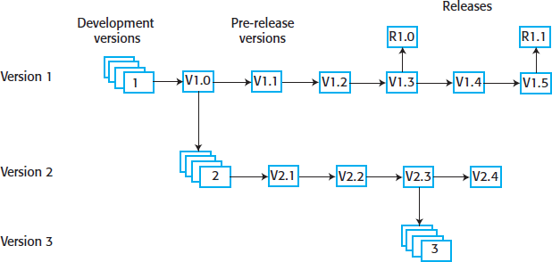
For large systems, there is never just one “working” version of a system; there are always several versions of the system at different stages of development.
Version 1.5 of the system has been developed to repair bug fixes and
improve the performance of the first release of the system.
It is the basis of the second system release (R1.1).
Version 2.4 is being tested with a view to it becoming release 2.0 of the system. No new features are being added at this stage.
Version 3 is a development system where new features are being added in response to change requests from customers and the development team. This will eventually be released as release 3.0.

Slide 15
CM Terminology
Term | Explanation
Baseline | A collection of component versions that make up a system. Baselines are controlled, which means that the component versions used in the baseline cannot be changed. It is always possible to re-create a baseline from its constituent components
Branching | The creation of a new codeline from a version in an existing codeline. The new codeline and the existing codeline may then develop independently.
Codeline | A set of versions of a software component and other configuration items on which that component depends.
Configuration (version) control | The process of ensuring that versions of systems and components are recorded and maintained so that changes are managed and all versions of components are identified and stored for the lifetime of the system.

Slide 16
Term | Explanation
Mainline | A sequence of baselines representing different versions of a system
Merging | The creation of a new version of a software component by merging separate versions in different codelines. These codelines may have been created by a previous branch of one of the codelines involved.
Release | A version of a system that has been released to customers (or other users in an organization) for use.
Repository | A shared database of versions of software components and meta information about changes to these components.
System building | The creation of an executable system version by compiling and linking the appropriate versions of the components and libraries making up the system.
Version | An instance of a configuration item that differs, in some way, from other instances of that item. Versions should always have a unique identifier.
Workspace | A private work area where software can be modified without affecting other developers who may be using or modifying that software.

Slide 17
VERSION MANAGEMENT
Version management is the process of keeping track of different versions of software components and the systems in which these components are used.
It also involves ensuring that changes made by different developers to these versions
do not interfere with each other.
Version management is the process of managing codelines and baselines. Codeline
A codeline is a sequence of versions of source code, with later versions in the
sequence derived from earlier versions.
Codelines normally apply to components of systems so that there are different
versions of each component.
Baseline
A baseline is a definition of a specific system.
The baseline specifies the component versions that are included in the system and
identifies the libraries used, configuration files, and other system information.
Mainline
The mainline is a sequence of system versions developed from an original baseline.

Slide 18
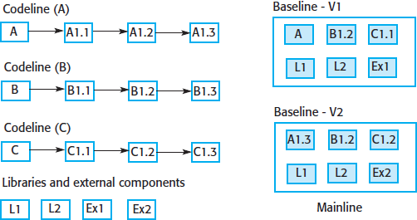

Slide 19
Version control (VC) systems identify, store, and control access to the different versions of components.
There are two types of modern version control system:
Centralized systems : A single master repository maintains all versions of the
software components that are being developed.
Distributed systems : A multiple versions of the component repository exist at
the same time.
Centralized and distributed VC systems provide comparable functionality but implement this functionality in different ways.
Key features of these systems include:
Version and Release Identification
Managed versions of a component are assigned unique identifiers when they are submitted to the system.
These identifiers allow different versions of the same component to be
managed, without changing the component name.
Versions may also be assigned attributes, with the set of attributes used to
uniquely identify each version.

Slide 20
Change History Recording
The VC system keeps records of the changes that have been made to create a new version of a component from an earlier version.
In some systems, these changes may be used to select a particular system
version.
This involves tagging components with keywords describing the changes made.
You then use these tags to select the components to be included in a baseline.
Independent Development
Different developers may be working on the same component at the same time.
The version control system keeps track of components that have been checked out for editing and ensures that changes made to a component by different developers do not interfere.
Project support
A version control system may support the development of several projects, which
share components.
It is usually possible to check in and check out all of the files associated with a
project rather than having to work with one file or directory at a time.

Slide 21
Most software development is a team activity, so several team members often work on the same component at the same time.
Let’s say Alice is making some changes to a system, which involves changing components A, B, and C. At the same time, Bob is working on changes that require making changes to components X, Y, and C. Both Alice and Bob are therefore changing C. It’s important to avoid situations where changes interfere with each other—Bob’s changes to C overwriting Alice’s or vice versa.
To support independent development without interference, all version control
systems use the concept of a project repository and a private workspace.
The project repository maintains the “master” version of all components, which is used to create baselines for system building.
When modifying components, developers copy (check-out) these from the repository into their workspace and work on these copies.
When they have completed their changes, the changed components are returned
(checked-in) to the repository

Slide 22
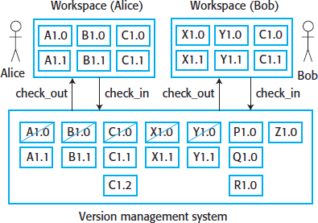
In centralized systems, developers check out components or directories of components from the project repository into their private workspace and work on these copies in their private workspace. When their changes are complete, they check-in the components back to the repository. This creates a new component version that may then be shared.
Alice has checked out versions A1.0, B1.0, and C1.0. She has worked on these versions and has created new versions A1.1, B1.1, and C1.1. She checks these new versions into the repository.
Bob checks out X1.0, Y1.0, and C1.0. He creates new versions of these components and checks them back in to the repository.
However, Alice has already created a new version of C, while Bob has been working on it.
His check-in therefore creates another version C1.2, so that Alice’s changes are not
overwritten.

Slide 23
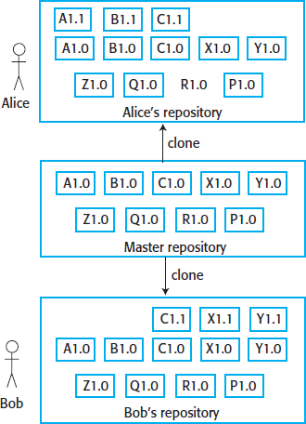
In a distributed VC system, such as Git, a different approach is used.
A “master” repository is created on a server that maintains the code produced by the development team.
Instead of simply checking out the files that they need, a developer creates a clone of the project repository that is downloaded and installed on his or her computer.
Developers work on the files required and maintain the new versions on their private repository on their own computer.
When they have finished making changes, they “commit” these changes and update their private server repository.
They may then “push” these changes to the project repository or tell the integration manager that changed versions are available.
Both Bob and Alice have cloned the project repository and have updated files.

Slide 24
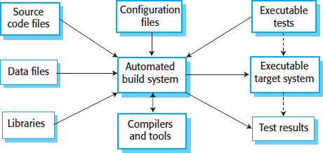
SYSTEM BUILDING
System building is the process of creating a complete, executable system by compiling and linking the system components, external libraries, configuration files, and other information.
System-building tools and version control tools must be integrated as the build process takes component versions from the repository managed by the version control system.
System building involves assembling a large amount of information about the software and its operating environment
An automated build tool is used to create a system build.
Ideally, you should be able to build a complete system with a single command or mouse click.

Slide 25
Tools for system integration and building include some or all of the following features
Feature | Description
Build Script Generation | The build system should analyze the program that is being built, identify dependent components, and automatically generate a build script (configuration file). The system should also support the manual creation and editing of build scripts.
Version Control System Integration | The build system should check out the required versions of components from the version control system.
Minimal Recompilation | The build system should work out what source code needs to be recompiled and set up compilations if required
Executable System Creation | The build system should link the compiled object code files with each other and with other required files, such as libraries and configuration files, to create an executable system.
Test Automation | Some build systems can automatically run automated tests using test automation tools such as JUnit.
Reporting | The build system should provide reports about the success or failure of the build and the tests that have been run.
Documentation Generation | The build system may be able to generate release notes about the build and system help pages

Slide 26
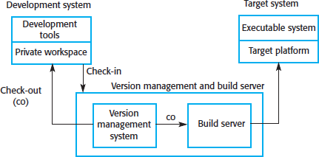
Building is a complex process in which three different system platforms may be involved
1. The Development System
Includes development tools such as
compilers and source code editors.
Developers check out code from the version control system into a private workspace before making changes to the system.
The Build Server
Used to build complete, executable versions of the system.
This server maintains the definitive versions of a system. All of the system developers check in code to the version control system on the build server for system building.
The Target Environment
Platform on which the system executes.
For real-time and embedded systems, the target environment is often smaller and simpler than the development environment .
For large systems, the target environment may include databases and other application
systems that cannot be installed on development machines.

Slide 27
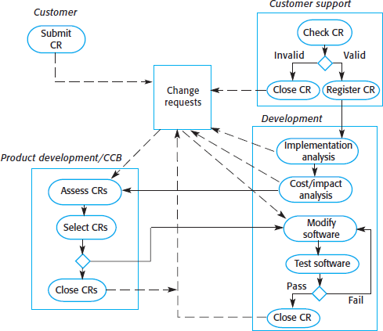
3. CHANGE MANAGEMENT
Change management
is the
process of
– analyzing benefits changes
approving
the costs and of
proposed
– those changes
that are cost-effective
– Tracking which components in the system have been changed.
This process should come into
effect
handed
when
over
the software is for release to for deployment
customers or
within an organization.

Slide 28
The Change Management Process is initiated when a system stakeholder completes and submits a change request describing the change required to the system.
This could be a bug report, where the symptoms of the bug are described, or a
request for additional functionality to be added to the system.
Change requests may be submitted using a Change Request Form (CRF).
Stakeholders may be system owners and users, beta testers, developers, or the
marketing department of a company.
Electronic change request forms record information that is shared between all groups involved in change management.
As the change request is processed, information is added to the CRF to record decisions made at each stage of the process.
At any time, it therefore represents a snapshot of the state of the change request.
In addition to recording the change required, the CRF records the recommendations regarding the change, the estimated costs of the change, and the dates when the change was requested, approved, implemented, and validated.
The CRF may also include a section where a developer outlines how the change may be implemented.

Slide 29
After a change request has been submitted, it is checked to ensure that it is valid.
The checker may be from a customer or application support team or, for internal
requests, may be a member of the development team.
The change request may be rejected at this stage.
If the change request is a bug report, the bug may have already been reported and
repaired.
Sometimes, what people believe to be problems are actually misunderstandings of what the system is expected to do. On occasions, people request features that have already been implemented but that they don’t know about.
If any of these features are true, the issue is closed and the form is updated with the reason for closure.
If it is a valid change request, it is then logged as an outstanding request for
subsequent analysis.

Slide 30
For valid change requests, the next stage of the process is change assessment and
costing.
This function is usually the responsibility of the development or maintenance team
as they can work out what is involved in implementing the change.
The impact of the change on the rest of the system must be checked.
To do this, you have to identify all of the components affected by the change.
If you need to change something and that change affects other parts of the system, it will cost more to make those additional changes.
Next, the required changes to the system modules are assessed.
Finally, the cost of making the change is estimated, taking into account the costs of
changing related components.

Slide 31
Following this analysis, a separate group decides if it is cost-effective for the
business to make the change to the software.
For military and government systems, this group is often called the Change Control
Board (CCB).
In industry, it may be called something like a “Product Development Group” responsible for making decisions about how a software system should evolve.
This team needs to check and agree on all requests for changes, except for small fixes
on things like screens, websites, or documents.
These small requests should be passed to the development team for immediate implementation.
The CCB or product development group considers the impact of the change from a
strategic and organizational rather than a technical point of view.
It decides whether the change in question is economically justified, and it prioritizes accepted changes for implementation.
Accepted changes are passed back to the development group.
Rejected change requests are closed and no further action is taken

Slide 32
The factors that influence the decision on whether or not to implement a change include:
The consequences of not making the change
When assessing a change request, you have to consider what will happen if the change is not implemented.
If the change is associated with a reported system failure, the seriousness of that failure has to be taken into account.
– If the system failure causes the system to crash, this is very serious, and failure to make the change may disrupt the operational use of the system.
If the failure has a minor effect, such as incorrect colors on a display, then it is not
important to fix the problem quickly.
The change should therefore have a low priority.
2. The benefits of the change
Will the change benefit many users of the system, or will it only benefit the change proposer?

Slide 33
The number of users affected by the change
If only a few users are affected, then the change may be assigned a low priority.
Actually, changing something might not be a good idea if it means most users of the system have to adjust to it.
The costs of making the change
If making the change affects many system components (hence increasing the chances of introducing new bugs) and/or takes a lot of time to implement, then the change may be rejected.
The product release cycle
If a new version of the software has just been released to customers, it may make sense to delay implementation of the change until the next planned release.

Slide 34
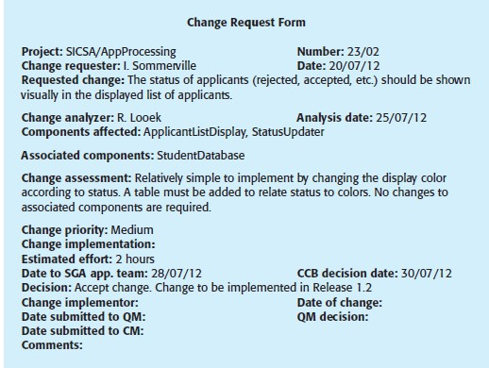
A partially completed change request form

Slide 35
4. RELEASE MANAGEMENT
A system release is a version of a software system that is distributed to customers.
For mass-market software, it is usually possible to identify two types of release:
major releases, which deliver significant new functionality
minor releases, which repair bugs and fix customer problems that have been reported
Major releases are very important economically to the software vendor, as customers
usually have to pay for them.
Minor releases are usually distributed free of charge.
A software product release is not just the executable code of the system.
The release may also include:
Configuration files defining how the release should be configured for particular installations
Data files, such as files of error messages in different languages, that are needed for
successful system operation
An installation program that is used to help install the system on target hardware
Electronic and paper documentation describing the system
Packaging and associated publicity that have been designed for that release.

Slide 36
The various technical and organizational factors should be considered when deciding on when to release a new version of a software product
Factor | Description
Competition | For mass-market software, a new system release may be necessary because a competing product has introduced new features and market share may be lost if these are not provided to existing customers.
Marketing Requirements | The marketing department of an organization may have made a commitment for releases to be available at a particular date. For marketing reasons, it may be necessary to include new features in a system so that users can be convinced to upgrade from a previous release.
Platform Changes | You may have to create a new release of a software application when a new version of the operating system platform is released.
Technical Quality of the System | If serious system faults are reported that affect the way in which many customers use the system, it may be necessary to correct them in a new system release. Minor system faults may be repaired by issuing patches, distributed over the Internet, which can be applied to the current release of the system.

Slide 37
Release creation is the process of creating the collection of files and documentation
that include all components of the system release.
This process involves several steps:
Executable code of the programs and all associated data files must be identified in the version control system and tagged with the release identifier.
Configuration descriptions may have to be written for different hardware and operating systems.
Updated instructions may have to be written for customers who need to configure their own systems.
Scripts for the installation program may have to be written.
Web pages have to be created describing the release, with links to system documentation.
Executable master image of the software must be prepared and handed over for
distribution to customers or sales outlets.

Slide 38
When planning the installation of new system releases, you cannot assume that
customers will always install new system releases.
Some system users may be happy with an existing system and may not consider it worthwhile to absorb the cost of changing to a new release.
New releases of the system cannot, therefore, rely on the installation of previous releases.
To illustrate this problem, consider the following scenario:
Release 1 of a system is distributed and put into use.
Release 2 requires the installation of new data files, but some customers do
not need the facilities of release 2 and so remain with release 1.
Release 3 requires the data files installed in release 2 and has no new data
files of its own.

Slide 39
Reengineering

Slide 40
Reengineering
Software Re-engineering is a process of software development that is done to
improve the maintainability of a software system.
Reengineering may involve
redocumenting the system,
refactoring the system architecture,
translating programs to a modern programming language,
modifying and updating the structure and values of the system’s data.
Reengineering has two important advantages over replacement:
Reduced risk
Redeveloping business-critical software poses significant risks due to potential errors in system specification and development, leading to delays, loss of business, and additional costs.
Reduced cost
The cost of reengineering may be significantly less than the cost of developing new software.

Slide 41
Reengineering is a rebuilding activity.
Consider an analogous activity: Rebuilding of a house
You’ve purchased a house in another state. You’ve never actually seen the property, but you acquired it at an amazingly low price, with the warning that it might have to be completely rebuilt. How would you proceed?
Before you can start rebuilding, it would seem reasonable to inspect the house. To determine whether it is in need of rebuilding, you (or a professional inspector) would create a list of criteria so that your inspection would be systematic.
Before you tear down and rebuild the entire house, be sure that the structure is weak. If the house is structurally sound, it may be possible to “remodel” without rebuilding (at much lower cost and in much less time).
Before you start rebuilding be sure you understand how the original was built. Take a
peek behind the walls. Understand the wiring, the plumbing, and the structural internals.
If you begin to rebuild, use only the most modern, long-lasting materials. This may cost a bit more now, but it will help you to avoid expensive and time-consuming maintenance later.
If you decide to rebuild, be disciplined about it. Use practices that will result in high quality—today and in the future

Slide 42
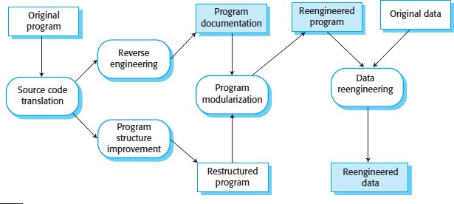
Reengineering Process Model
The input to the process is a legacy
program, output improved
and the
is an
and
restructured version
of the same program.
The activities in this
reengineering process are:
Source Code Translation
Using a translation tool, you can convert the program from an old programming language to a more modern version of the same language or to a different language.
Reverse engineering
The program is analyzed and information extracted from it.
This helps to document its organization and functionality.
Again, this process is usually completely automated.

Slide 43
Program Structure Improvement
The control structure of the program is analyzed and modified to make it easier to
read and understand.
This can be partially automated, but some manual intervention is usually required.
4. Program Modularization
Related parts of the program are grouped together, and, where appropriate,
redundancy is removed.
In some cases, this stage may involve architectural refactoring (e.g., a system that uses several different data stores may be refactored to use a single repository). This is a manual process.
Data reengineering
The data processed by the program is changed to reflect program changes.
This may mean redefining database schemas and converting existing databases to
the new structure.
You should usually also clean up the data.
This involves finding and correcting mistakes, removing duplicate records, and so on.
This can be a very expensive and prolonged process.

Slide 44
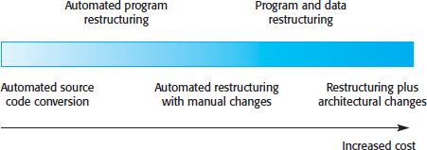
The costs of reengineering obviously depend on the extent of the work that is carried
out.
There is a spectrum of possible approaches to reengineering
Costs increase from left to right so that source code translation is the cheapest option, and reengineering, as part of architectural migration, is the most expensive.

Slide 45
Reverse Engineering

Slide 46
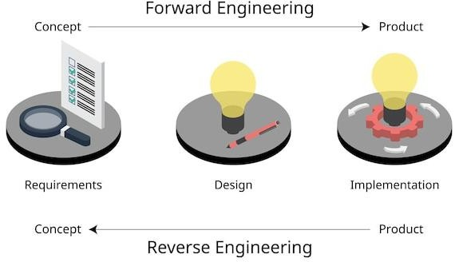
Reverse Engineering
Reverse Engineering is processes of extracting knowledge or design information from anything man-made and reproducing it based on extracted information.
It is also called back Engineering.
Reverse engineering requires developers to evaluate the old software system by examining its (often undocumented) source code, developing a meaningful specification of the processing being performed, the user interface that was used, and the program data structures or associated database.

Slide 47
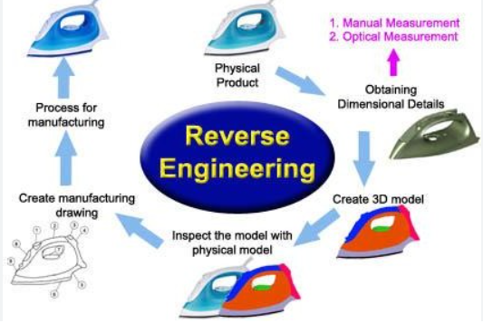

Slide 48
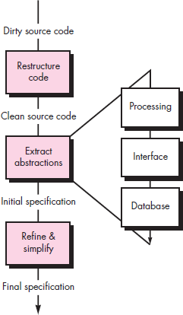
Reverse engineering process
Before reverse engineering activities can commence, unstructured (“dirty”) source code is restructured so that it contains only the structured programming constructs.
This makes the source code easier to read and provides the basis for all the subsequent reverse engineering activities.
The core of reverse engineering is an activity called extract abstractions

Slide 49
Reverse Engineering to Understand Data
This occurs at different levels of abstraction and is often the first reengineering task.
In some cases, the first reverse engineering activity attempts to construct a UML class diagram.
At the program level, internal program data structures must often be reverse engineered as part of an overall reengineering effort.
At the system level, global data structures (e.g., files, databases) are often reengineered to accommodate new database management paradigms (e.g., the move from flat file to relational or object-oriented database systems).
Internal Data Structures
Reverse engineering techniques for internal program data focus on the definition of object classes.
This is accomplished by examining the program code with the intent of grouping related program variables together.
In many cases, the data organization within the code suggests several abstract data types.
For example, record structures, files, lists, and other data structures often provide initial suggestions for possible classes.

Slide 50
Database Structure
Database allows the definition of data objects and supports some method for
establishing relationships among the objects.
Reengineering one database schema into another requires an understanding of
existing objects and their relationships.
The following steps may be used to define the existing data model as a predecessor to reengineering a new database model:
Build an initial object model
Determine candidate keys
Refine the tentative classes
Define generalizations
Discover associations using techniques that are analogous to the CRC
approach

Slide 51
Reverse engineering to understand processing
Begins with an attempt to understand and then extract procedural abstractions
represented by the source code.
To understand procedural abstractions, the code is analyzed at varying levels of abstraction: system, program, component, pattern, and statement.
The overall functionality of the entire application must be understood before more detailed reverse engineering work occurs.
This establishes a context for further analysis and provides insight into interoperability issues among applications within a larger system.
Each of the programs that make up the system represents a functional abstraction at
a high level of detail.
A block diagram, representing the interaction between these functional
abstractions, is created.
Each component performs some subfunction and represents a defined procedural abstraction.
A processing narrative for each component is developed.

Slide 52
Reverse engineering to understand user interfaces
Need to be done as part of the maintenance task.
The redevelopment of user interfaces has become one of the most common types of
reengineering activity.
But before a user interface can be rebuilt, reverse engineering should occur.
To fully understand an existing user interface, the structure and behavior of the
interface must be specified.
Three basic questions that must be answered as reverse engineering of the UI commences:
What are the basic actions (e.g., keystrokes and mouse clicks) that the interface
must process?
What is a compact description of the behavioral response of the system to these
actions?
What is meant by a “replacement,” or more precisely, what concept of equivalence of interfaces is relevant here?

Slide 53
Software Reuse

Slide 54
SOFTWARE REUSE
Reuse-based software engineering is an approach to development that tries to maximize the reuse of existing software.
The software units that are reused may be of radically different sizes.
System Reuse :
Complete systems, which may be made up of a number of application programs, may be reused as part of a system of systems.
Application Reuse
An application may be reused by incorporating it without change into other systems or by configuring the application for different customers.
Component Reuse
Components of an application, ranging in size from subsystems to single objects, may be reused.
Object and Function Reuse
Software components that implement a single function, such as a mathematical function, or an object class may be reused.

Slide 55
Benefits of Software Reuse
Benefit | Explanation
Increased Dependability | Reused software, which has been tried and tested in working systems, should be more dependable than new software. Its design and implementation faults should have been found and fixed.
Reduced Process Risk | The cost of existing software is already known, whereas the costs of development are always a matter of judgment. This is an important factor for project management because it reduces the margin of error in project cost estimation.
Effective use of Specialists | Instead of doing the same work over and over again, application specialists can develop reusable software that encapsulates their knowledge.
Standards Compliance | Some standards, such as user interface standards, can be implemented as a set of reusable components. For example, if menus in a user interface are implemented using reusable components, all applications present the same menu formats to users.
Accelerated development | Bringing a system to market as early as possible is often more important than overall development costs. Reusing software can speed up system production because both development and validation time may be reduced.

Slide 56
Problems with Software Reuse
Problem | Explanation
Increased Maintenance Costs | If the source code of a reused software system or component is not available then maintenance costs may be higher because the reused elements of the system may become increasingly incompatible with system changes.
Lack of tool support | Some software tools do not support development with reuse. It may be difficult or impossible to integrate these tools with a component library system. The software process assumed by these tools may not take reuse into account. This is particularly true for tools that support embedded systems engineering, less so for object-oriented development tools.
Not-invented- here syndrome | Some software engineers prefer to rewrite components because they believe they can improve on them. This is partly to do with trust and partly to do with the fact that writing original software is seen as more challenging than reusing other people’s software.

Slide 57
Problems with software reuse
Problem | Explanation
Creating, Maintaining, and using a component library | Populating a reusable component library and ensuring the software developers can use this library can be expensive. Development processes have to be adapted to ensure that the library is used.
Finding, Understanding, and Adapting reusable components | Software components have to be discovered in a library, Understood and, sometimes, adapted to work in a new environment. Engineers must be reasonably confident of finding a component in the library before they include a component search as part of their normal development process.

Slide 58
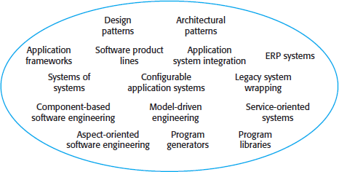
1. The reuse landscape
Reuse is often simply thought of as the reuse of system components, there are many
different approaches to reuse that may be used.
Reuse is possible at a range of levels from simple functions to complete application systems.
The reuse landscape covers the range of possible reuse techniques.

Slide 59
Approaches that support software reuse
Approach | Description
Architectural Patterns | Standard software architectures that support common types of application systems are used as the basis of applications.
Design Patterns | Generic abstractions that occur across applications are represented as design patterns showing abstract and concrete objects and interactions.
Component-Based Development | Systems are developed by integrating components (collections of objects) that conform to component-model standards.
Application Frameworks | Collections of abstract and concrete classes are adapted and extended to create application systems.
Legacy System Wrapping | Legacy systems are ‘wrapped’ by defining a set of interfaces and providing access to these legacy systems through these interfaces.
Service-Oriented Systems | Systems are developed by linking shared services, which may be externally provided.
Software Product Lines | An application type is generalized around a common architecture so that it can be adapted for different customers.

Slide 60
Approach | Description
COTS Product Reuse | Systems are developed by configuring and integrating existing application systems.
ERP Systems | Large-scale systems that encapsulate generic business functionality and rules are configured for an organization.
Configurable Vertical Applications | Generic systems are designed so that they can be configured to the needs of specific system customers.
Program Libraries | Class and function libraries that implement commonly used abstractions are available for reuse.
Model-Driven Engineering | Software is represented as domain models and implementation independent models and code is generated from these models.
Program Generators | A generator system embeds knowledge of a type of application and is used to generate systems in that domain from a user-supplied system model.
Aspect-Oriented Software Development | Shared components are merged into an application at different places when the program is compiled.

Slide 61
Key factors that should be considered when planning reuse are:
The development schedule for the software
If the software has to be developed quickly, you should try to reuse complete
systems rather than individual components.
Although the fit to requirements may be imperfect, this approach minimizes the
amount of development required.
The expected software lifetime
If you are developing a long-lifetime system, you should focus on the maintainability of the system.
You should not just think about the immediate benefits of reuse but also of the long-
term implications.
The background, skills and experience of the development team
All reuse technologies are fairly complex, and you need quite a lot of time to understand and use them effectively. Therefore, you should focus your reuse effort in areas where your development team has expertise.

Slide 62
The criticality of the software and its non-functional requirements
For a critical system that has to be certified by an external regulator you may have
to create a safety or security case for the system.
This is difficult if you don’t have access to the source code of the software.
If your software has stringent performance requirements, it may be impossible to
use strategies such as model-driven engineering (MDE)
The application domain
In many application domains, such as manufacturing and medical information systems, there are generic products that may be reused by configuring them to a local situation.
This is one of the most effective approaches to reuse, and it is almost always cheaper to buy rather than build a new system.
The platform on which the system will run
Some components models, such as .NET, are specific to Microsoft platforms.
Similarly, generic application systems may be platform-specific, and you may only be
able to reuse these if your system is designed for the same platform

